Slide 1
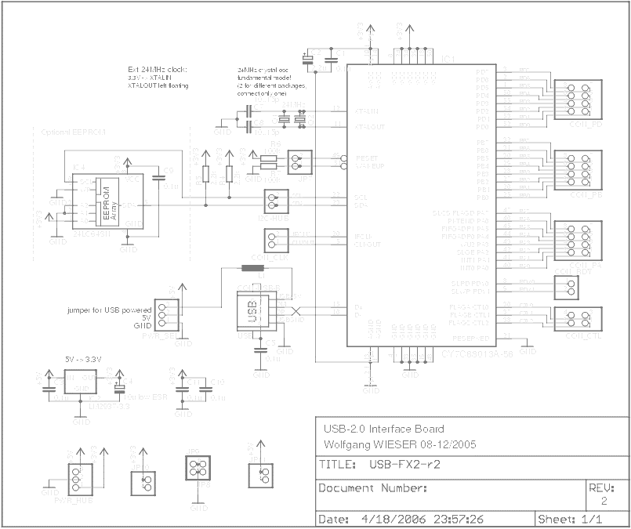



Low Level USB with .NET
Building your own gadgets without a PI or an Arduino.
Peter “Shawty” Shaw/Digital Solutions UK

Slide 2
Introduction
If you’ve not met me before, then you can stalk me via the following means:
Email – shawty.d.ds@googlemail.com
Twitter - @shawty_ds
Linked-in – “Peter Shaw”/”LiDNUG” (The online .NET user group I help run)
The code for this session is available from my Github repo at:
https://github.com/shawty/lowlevelusb

Slide 3
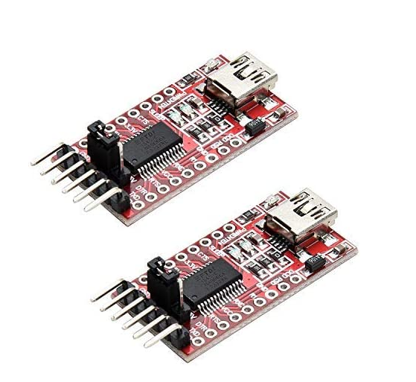
Introduction
How many of you recognise these:

Slide 4
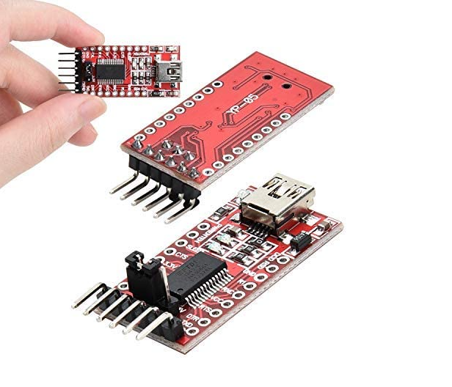
Introduction
If you recognise them as a UART / USB Serial port, then tonight hopefully, your going to find out they can do quite a bit more than just standard serial communications.

Slide 5
When is a UART not a UART?
Most people purchase these devices for their intended use, to add a USB serial port to devices running 5V logic.
As a result, they often just solder on the minimum of pins needed at the end of the board, to gain access to the normal serial lines.
The devices from stock can be connected to any line marked RX/TX on pretty much any device you come across.
They can even be connected to a Raspberry PI on pins 8 & 10 with a suitable logic level converter to give your device a serial console.

Slide 6
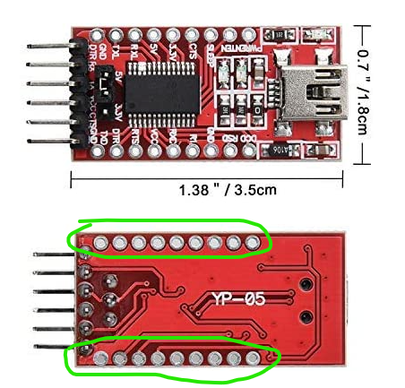
When is a UART not a UART?
Look carefully however, you’ll see on most boards that there are far more pins than needed for regular serial operations.
These smaller boards have a chip on them, that’s more like a CPU (But dedicated for serial data) than just a simple USB to serial converter.
In the case of these small red devices, the chip is an FTDI232R (FT232R) for short

Slide 7
When is a UART not a UART?
The clever part about all these pins however, aside from their intended use for status LED’s, is that they can be toggled independently directly under software control.
Not just the indicator pins for LED’s but the serial data pins too.
This allows us to perform some interesting “Bit Banging” scenarios.

Slide 8
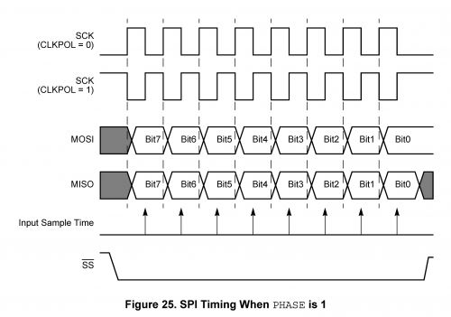
Want is Bit Banging?
Despite how it sounds, Bit Banging is the process of directly controlling single wires in a digital system, to perform complex protocol transmissions, such as I2C, SPI and other bus orientated connections.
If you have ever used “Software Serial” on an Arduino, then you’ve performed “Bit Banging”.

Slide 9
Want is Bit Banging?
The FT232R as a “Serial Processor” allows you to “Bit Bang” but without any complex software.
Like A CPU, you send “commands” to it in the form of bytes.
If you ever did any machine code programming, esp on older 8-bit micros such as the 6502/Z80 or 6809, the idea is exactly the same.
With the FT232R, the commands you send it, tell it things like how/when to cycle the clock line, when/how to change the serial data line, generally much faster and more precise than you can do in pure code, toggling GPIO pins.

Slide 10
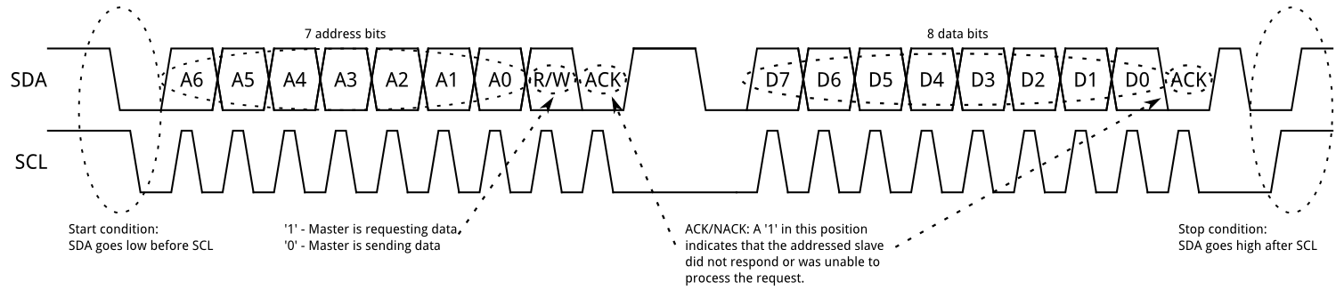
Bit Banging an I2C signal?
Hopefully everyone here is familiar with I2C….

Slide 11
Programming the FT232R
The FT232R can easily produce this timing wave form, and others too such as SPI.
The manufacturers of the FT232R, provide a programmers toolkit that works with .NET/C#
You don’t have to use .NET however, there are language bindings for just about every language & every platform (Windows, Linux, Mac, rPI… and so on)
The dll used to access this functionality is called “D2XXX” and can be downloaded free of charge from the FTDI website.
Notes:
FTDI website

Slide 12
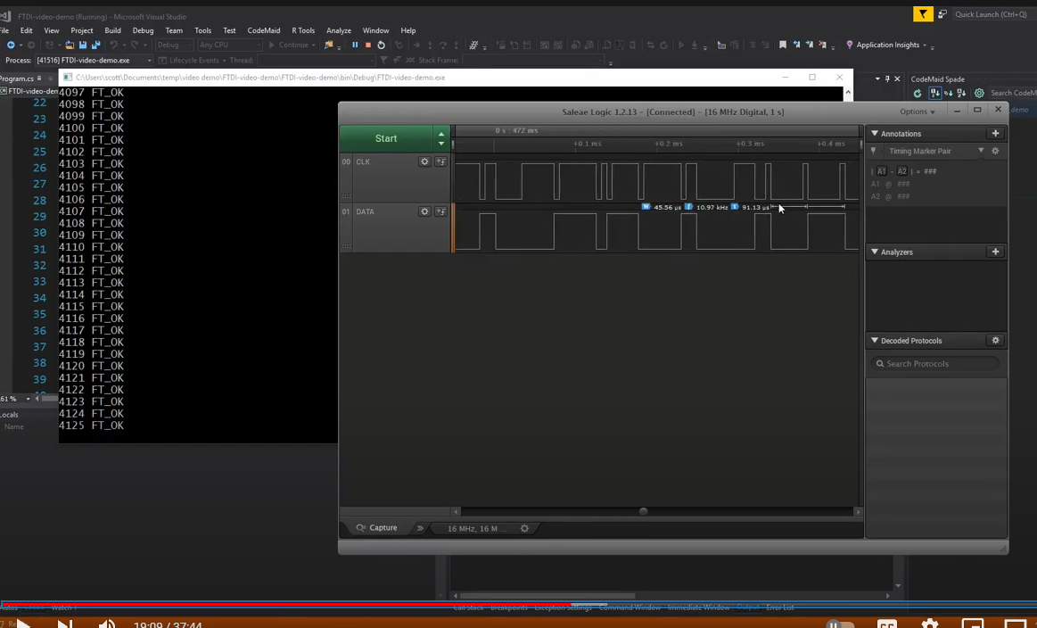
Programming the FT232R
While all of this looks really great, and something neat to play with, the FT232R unfortunately has one very big problem, shown neatly by “Scott Harden” in his you tube video at:
https://www.youtube.com/watch?v=QkHsryvDZfo
The FT232 has a serious timing bug in the silicon itself.
Notes:
FTDI website

Slide 13
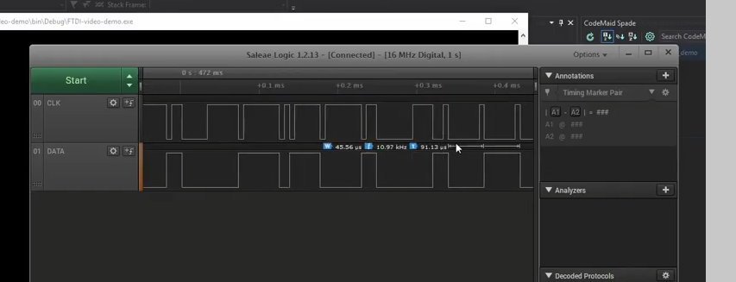
Programming the FT232R
Notes:
FTDI website

Slide 14
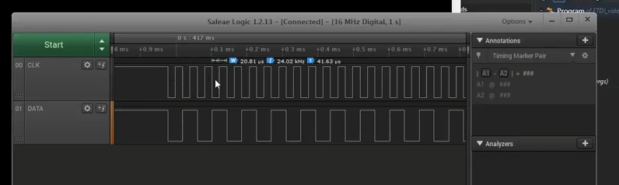
Programming the FT232R
Notes:
FTDI website

Slide 15
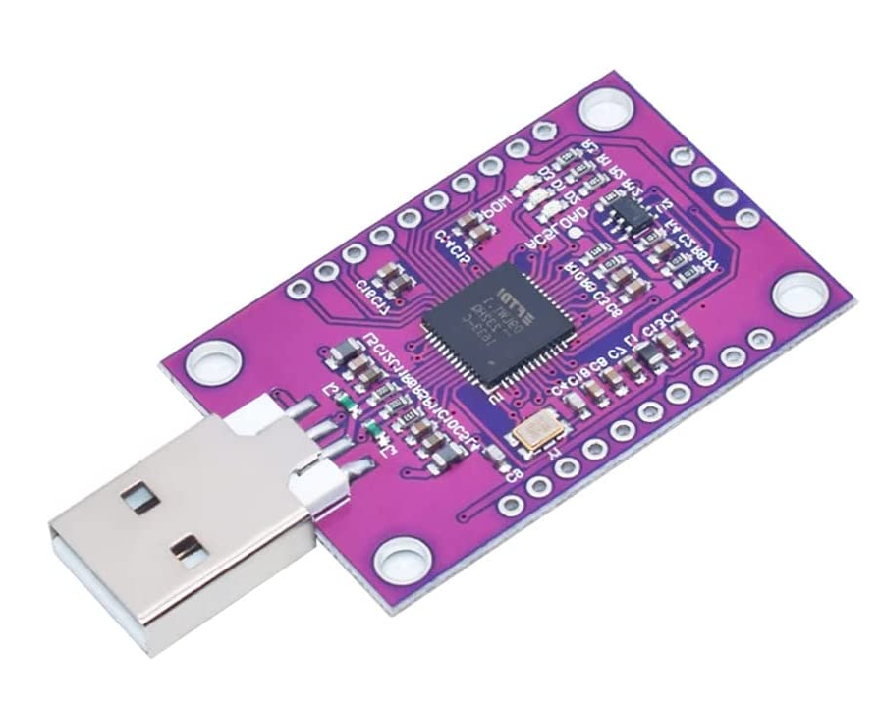
Introducing the FT232H
FTDI came up with a solution to the problem, in the form of a completely new device:

Slide 16
Introducing the FT232H
The FT232H has been completely re-designed from scratch, and features a new serial processor called “Multi-Protocol Synchronus Serial Engine”
“MPSSE” for short
The new processor has specific commands to tell it, switch to I2C mode, switch to UART mode, Switch to SPI mode.

Slide 17
Introducing the FT232H
It’s also very fast, with a minimum on-board clock speed of 60Mhz built directly into the chip’s silicon.
It’s easily capable of running an 800Khz I2C bus, even though the standard “Fast Bus” is only 400Khz

Slide 18
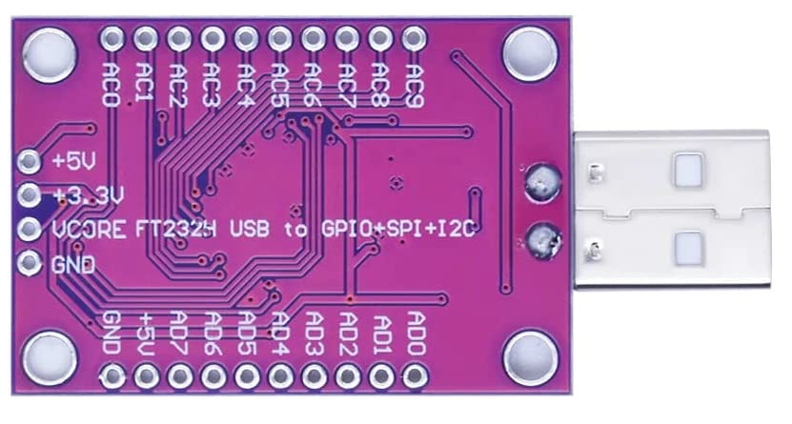
Introducing the FT232H
If you look on the underneath of the FT232H board, you’ll see that the pin naming no longer is specific to standard UART protocols.

Slide 19
Introducing the FT232H
This is because the FT232H from a software point of view labels it’s ports as 2 8-Bit GPIO ports.
All 8 lines can be controlled independently and like many GPIO systems in use, can be designated as inputs or outputs, and be changed under software control.
For SERIAL based protocols such as SPI, I2C and Uart the important pins are:

Slide 20
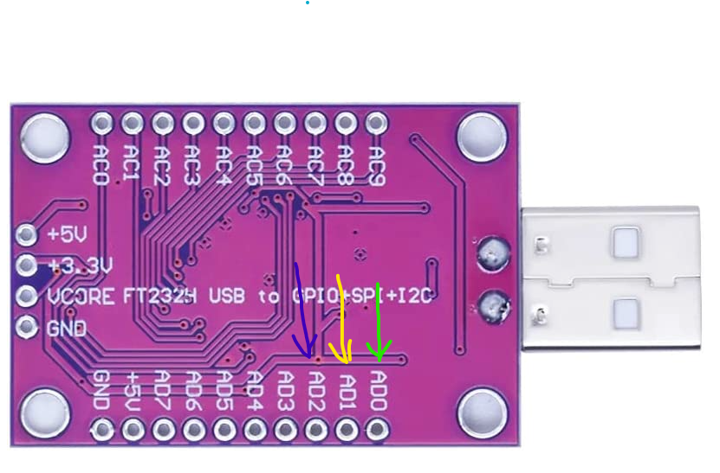
Introducing the FT232H
AD0 (Clock) [Green], AD1 (Serial Data In) [Yellow], AD2 (Serial Data Out) [Blue]

Slide 21
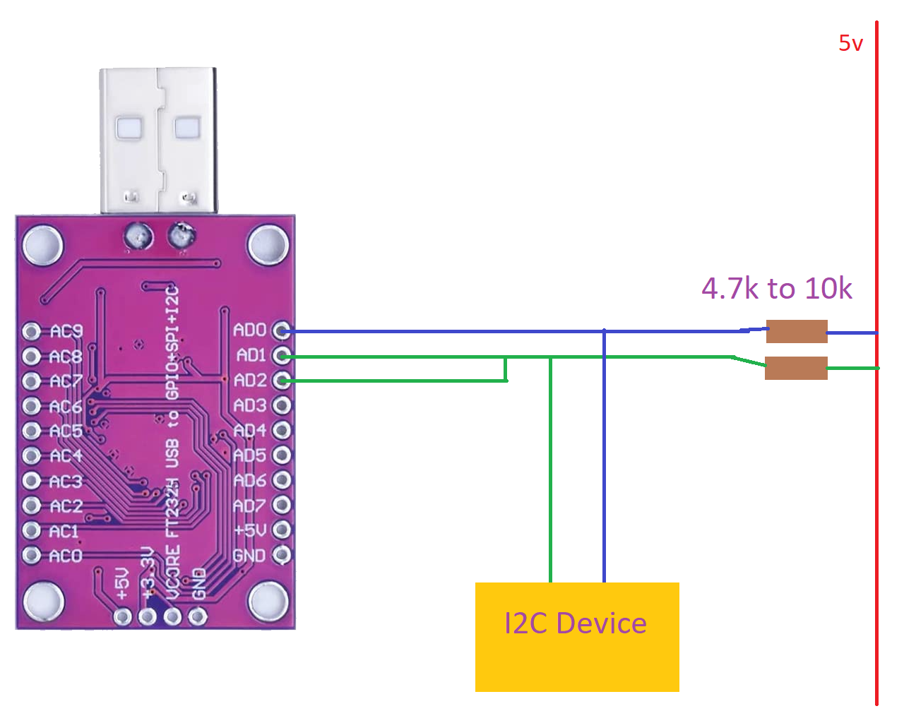
Introducing the FT232H
A suitable circuit to connect this all up, would look something like the following:

Slide 22
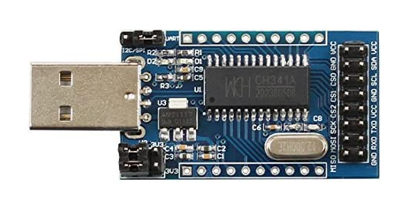
Buyer beware
With a device as popular is this, it’ll come as no surprise the Chinese markets are flooded with clone devices called a CH341A:

Slide 23
Buyer beware
Despite what the listings tell you, these ARE NOT the same as the FT232H. They do, do the same thing, but the SDK (when you manage to find it) is entirely written in Chinese and will not be provided in English!!

Slide 24
Buyer beware
If you do a search for CH341A on places like you-tube, you’ll find a huge amount of devices used to hack eeprom’s in Cars, TV’s and anything else that has a CPU, those eeprom programmers are built round this chip.

Slide 25
To be continued….
That’s all for the printed word for now……
When we come back, after the break, we’ll take a look at some of the code used to drive this chip, and have a look at some wiring up on the bread board.

